Slide 1

Chapter 7: Sorting
Revision Basic Sorts, Quicksort

Slide 2
Interesting website
https://rebootjeff.github.io/comparisonsort/
Demos of performance for various sorting methods.

Slide 3
Sorting Methods
Assumption that you know:
Bubblesort
Insertion Sort
Selection Sort
Radix Sort (all year 2)
Heap Sort (previous lecture)
Look at website link recommended in previous slide

Slide 4
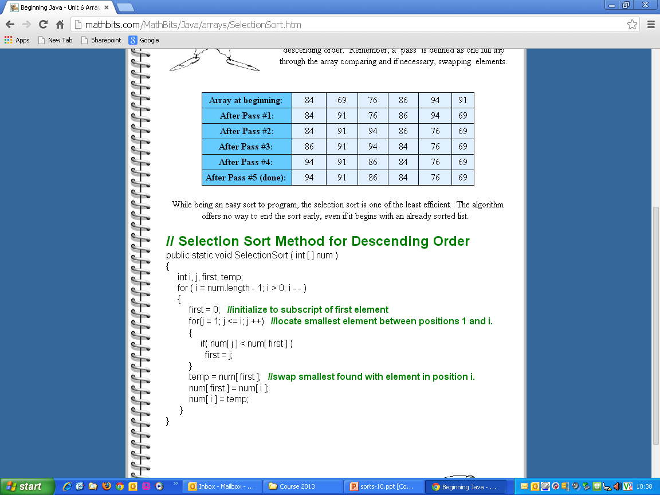
http://mathbits.com/MathBits/Java/arrays/SelectionSort.htm

Slide 5
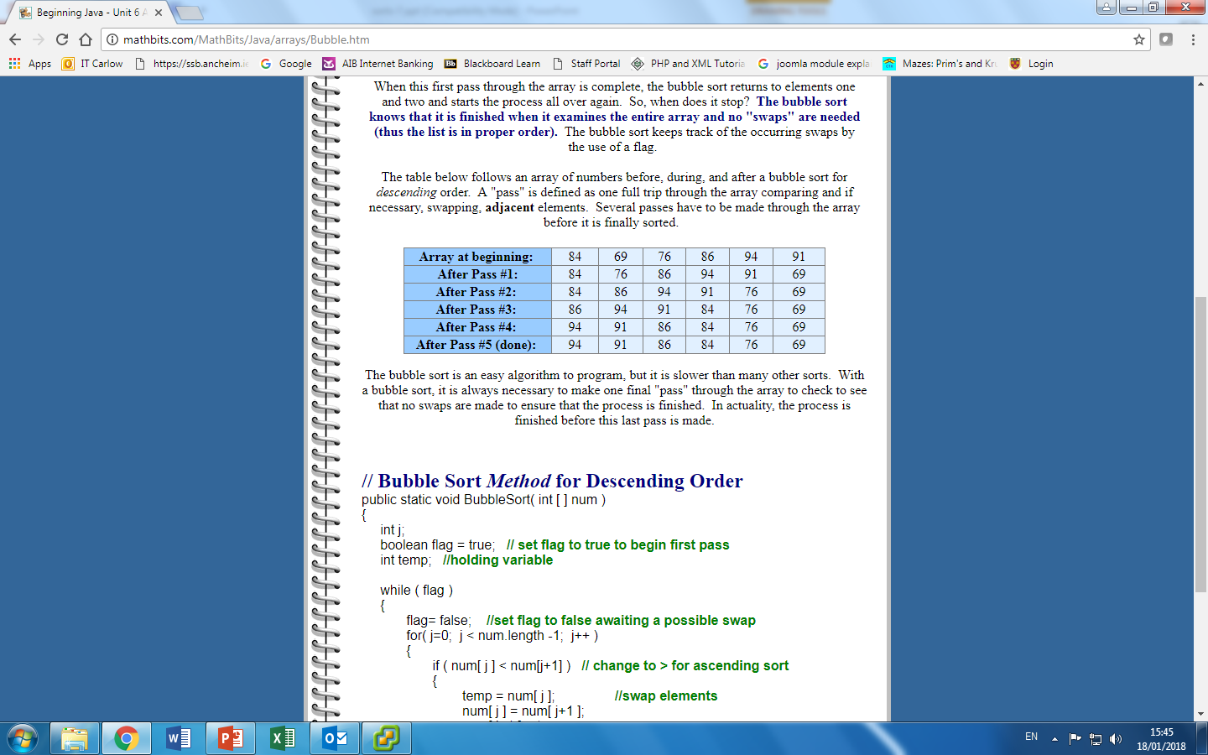
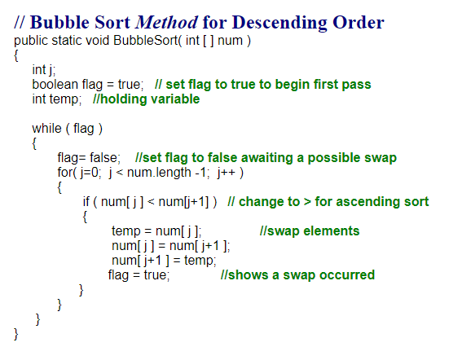
http://mathbits.com/MathBits/Java/arrays/Bubble.htm

Slide 6
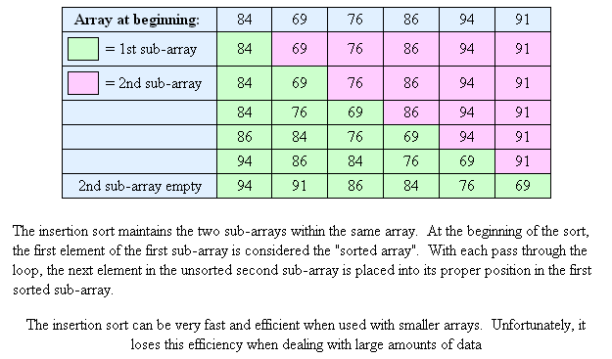
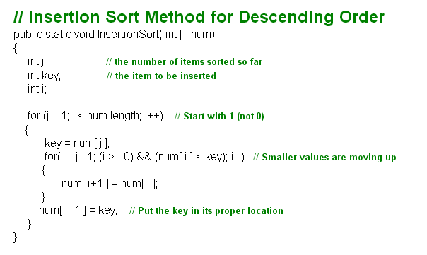
Reference: http://mathbits.com/MathBits/Java/arrays/InsertionSort.htm

Slide 7
Advanced Sorting technique
Quick Sort
More efficient exchange sort than the bubble sort because a typical exchange involves elements that are far apart so that fewer interchanges are required to correctly position an element.
Basic idea is to choose some element called a pivot and then perform a sequence of exchanges such that all elements that are <= this pivot are to it's left and all elements > pivot are to it's right.

Slide 8
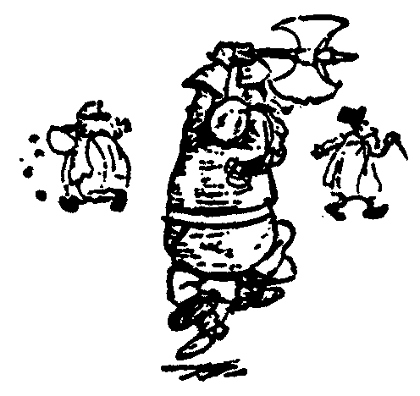
Quick Sort
88
52
14
31
98
25
30
62
23
79
Divide and Conquer

Slide 9
Quick Sort
Partition set into two using chosen pivot
88
52
14
31
98
25
30
62
23
79
14
88
98
31
30
≤ 52 ≤
62
25
23
79

Slide 10
Quick Sort
14
88
98
31
30
≤ 52 ≤
62
25
23
79
Get one friend to sort the first half.
Get one friend to sort the second half.
14,23,25,30,31
62,79,98,88

Slide 11
Quick Sort
14,23,25,30,31
52
62,79,98,88
Glue pieces together. (No real work)
14,23,25,30,31,52,62,79,88,98

Slide 12
Quicksort
This correctly positions the pivot and divides the list into 2 smaller sub-lists, each of which may be sorted independently in the same way.
The sorting problem is said to have been partitioned. This divide and conquer strategy leads naturally to a recursive sorting algorithm.

Slide 13
Quicksort
70 65 84 98 78 100 93 55 61 81 68
select 75 (first element) as pivot.
Carry out 2 searches, one from right for elements <= 75, and one from left for elements > 75.
Left 84 Right 68
These are exchanged
70 65 68 98 78 100 93 55 61 81 84
Continue the left and right scans..
70 65 68 98 78 100 93 55 61 81 84
75
75

Slide 14
Quicksort
70 65 68 98 78 100 93 55 61 81 84
Continue the left and right scans..
Swap 98 - 61
70 65 68 61 78 100 93 55 98 81 84
Continue the left and right scans..
Swap 78 -55
70 65 68 61 55 100 93 78 98 81 84
Continue the left and right scans until they overlap
75
75
75

Slide 15
Quicksort
75 70 65 68 61 55 100 93 78 98 81 84
When the search overlaps, stop searching from left, only from the right. Choose 55 (number < pivot), the pivot element is then interchanged with this element.
Swap 75 - 55
70 65 68 61 75 100 93 78 81 84
Now, all elements to the left of 75 are <= 75 and all to the right are > 75, and 75 has been properly positioned. These sublists can now be sorted independently.

Slide 16
procedure SPLIT(Array x, int first, int last , int pos) {
// pos = position of pivot returned.
int left, right
ElementType pivot
{
pivot = x[first];
left = first;
right = last;
while left < right do
{
while x[right] > pivot do
right = right -1;
while left < right AND x[left] <= pivot do
left = left +1;
if left < right then
Swap(x[left], x[right]);
}
pos = right
x[first] = x[pos]
x[pos] = pivot
}

Slide 17
Quicksort
procedure QUICKSORT (Array x, int first, int last) {
int pos // final position of pivot
if first < last then
{
SPLIT (x, first, last, pos)
QUICKSORT (x, first, pos-1) // left sublist
QUICKSORT (x, pos+1, last) // right sublist
}
}

Slide 18
Improvements to the Quicksort
Select the pivot at each stage more carefully. Since we only choose the first element as the pivot, this would be disastrous if the list were already sorted. One common method is the median of three rule, which selects the median of the first, middle and last elements in each sublist as the pivot.
2. Switch to a faster sorting method when the sublist is small, maybe the insertion sort which is quite efficient for less than 15 elements.

Slide 19
